Slide 1

BST 405: DIGITAL APPLICATION IN TAX PRACTICE AND ADMINISTRATION II (1, 4, 3)
Welcome to a course designed for BSC Taxation students and early-career tax professionals. This program will equip you with the essential knowledge and practical skills to navigate the complex landscape of digital taxation. We'll delve into compliance frameworks, technological solutions, and emerging trends to prepare you for the future of tax.

Slide 2












Core Pillars of Digital Tax Mastery
Compliance Frameworks
Technological Solutions
Analyze and understand global digital tax regulations.
Identify and implement advanced tax technology tools.
Emerging Trends
Digital Assets & Blockchain
Anticipate future developments, including AI in tax compliance.
Evaluate the tax implications of cryptocurrencies and DLT.
Data & Privacy
International Taxation
Manage taxpayer data securely and understand its intersection with taxation.
Address cross-border challenges and transfer pricing.

Slide 3
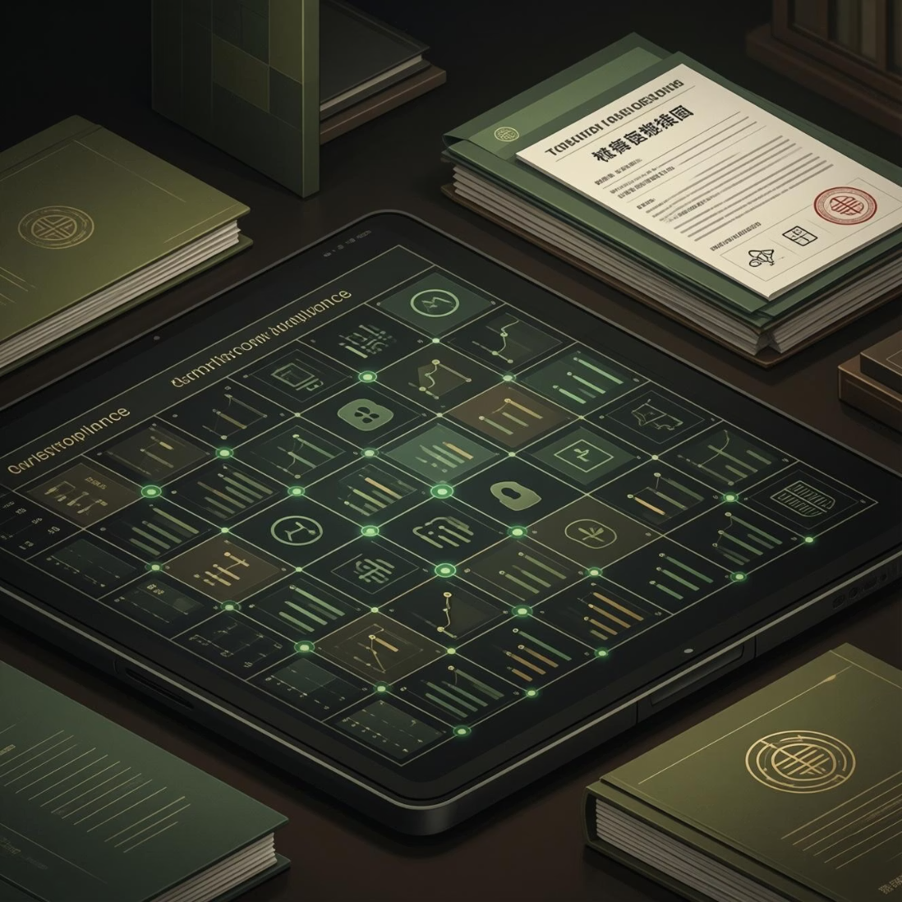
Navigating Compliance in a Digital World
1
Analyze Digital Tax Compliance Frameworks
Master the intricacies of various national and international digital tax regulations and their practical application.
2
Identify Compliance Challenges
Recognize and address specific digital tax compliance challenges inherent in complex digital transactions.
3
Develop Compliance Strategies
Formulate effective strategies to ensure robust digital tax compliance for businesses operating in the digital economy.
4
Understand OECD Guidelines
Gain a deep understanding of the Organization for Economic Co-operation and Development (OECD) guidelines for digital taxation.
5
Evaluate Cross-Border Issues
Assess and manage complex cross-border digital taxation issues, including permanent establishment and nexus.

Slide 4





Leveraging Technology for Tax Efficiency
Identify Tax Technology Solutions
Implement Automation Tools
Explore a wide array of tax technology solutions designed to streamline compliance processes.
Apply automation tools to enhance efficiency and accuracy in tax compliance operations.
Evaluate Tax Software Effectiveness
Analyze Blockchain Impact
Critically evaluate the utility and efficacy of tax software in digital tax practice and administration.
Investigate the transformative potential of blockchain technology on tax compliance and record-keeping.

Slide 5


E-commerce, Sales Tax & Transfer Pricing
E-commerce Tax Challenges
Transfer Pricing in Digital Transactions
E-commerce introduces unique complexities in sales tax collection and remittance across jurisdictions. This course helps you dissect these challenges and build robust solutions.
The intangible nature of digital goods and services complicates traditional transfer pricing rules. Learn how to apply these rules and appropriate benchmarking methods.
Identify sales tax challenges in e-commerce.
Understand transfer pricing rules in the digital economy.
Develop sales tax compliance strategies for e-commerce.
Apply benchmarking methods in digital transactions.
Develop comprehensive documentation for digital tax compliance.

Slide 6





Taxation of Digital Assets & Data Privacy
Analyze Digital Asset Taxation
Examine the diverse tax treatments applicable to various digital assets, including cryptocurrencies and NFTs.
Evaluate Capital Gains & Income Tax
Assess the capital gains and income tax implications arising from digital asset transactions.
Understand Regulatory Frameworks
Grasp the evolving regulatory landscapes governing digital assets and their tax consequences.
Data Privacy & Taxation Intersection
Explore the critical intersection of data privacy regulations and their impact on tax compliance and reporting.
Manage Taxpayer Data Securely
Develop and implement strategies for managing sensitive taxpayer data with utmost security and compliance.

Slide 7


Digital Tax Audits & Emerging Trends
Navigating Digital Tax Audits
Future of Digital Taxation
The digital age transforms how tax audits are conducted. Prepare for this new reality with strategic tools and methodologies.
Stay ahead of the curve by understanding the dynamic shifts and innovations shaping the future of digital taxation.
Analyze the digital tax audit process from initiation to resolution.
Identify emerging trends and paradigms in digital taxation.
Analyze the transformative role of Artificial Intelligence (AI) in tax compliance and advisory.
Identify cutting-edge tools for conducting efficient and accurate digital audits.
Develop comprehensive preparation strategies for digital tax audits to minimize risks.

Slide 8
Course Content Overview
This comprehensive course covers a wide spectrum of topics, ensuring you gain a holistic understanding of digital taxation. From foundational compliance to advanced future trends, every module is meticulously designed to provide actionable insights and practical skills.
1
Advanced Digital Tax Compliance
2
International Taxation in a Digital Economy
3
Tax Technology Tools and Software
4
Blockchain and Digital Taxation
5
E-Commerce and Sales Tax
6
Transfer Pricing in Digital Transactions
7
Taxation of Digital Assets
8
Data Privacy and Taxation
9
Digital Tax Audits
10
Future Trends in Digital Taxation

Slide 9


Interactive Learning & Capstone Experience
Dynamic Mode of Delivery
Capstone Project: Synthesize & Defend
This program utilizes an interactive 'Digital Transformation of Tax Administration' approach, blending various teaching methodologies to maximize learning and engagement.
The culmination of your learning journey will be a comprehensive capstone project, allowing you to apply all acquired knowledge in a real-world context.
Lectures / Demonstrations
Synthesize knowledge from the entire course into a practical project.
Seminars & Presentations
Group Discussions & Assignments
Develop, present, and effectively defend a comprehensive digital taxation strategy.
Case Studies & Functional Exercises
The 'Do-Review-Learn-Apply' Model

Slide 10
Essential Reading Materials
To complement the course content and foster continuous learning, a curated selection of reading materials is provided. These resources will deepen your understanding and keep you updated on the latest developments in digital taxation.
GRA Guidelines & OECD Reports
Access official guidelines and foundational reports on digital tax compliance and international taxation.
Tax Software Reviews & Manuals
Delve into reviews of leading tax software solutions and user manuals for practical application.
Blockchain & Taxation Research
Explore research papers and case studies on the impact of blockchain on tax and finance.
Transfer Pricing Guidelines
Refer to the OECD transfer pricing guidelines for digital transactions.
AI & Future Tax Trends
Stay informed with articles and reports on AI applications and future trends in taxation.

